Slide 1
React Native
Shelby Kuchta and John Valin

Slide 2
History of React Native
Summer of 2013 - internal hackathon project at Facebook
January 2015 - first public preview
March 2015 - available on Github
2018 - 2nd highest number of contributors for any GitHub repository
Notes:
https://medium.com/react-native-development/a-brief-history-of-react-native-aae11f4ca39
Shelby

Slide 3
What is React Native?
-JavaScript framework for writing native mobile applications
-based on React
-cross-platform compatibility
Notes:
-open-source framework
-difference between React and React Native it targets mobile platforms instead of the browser for building User Interfaces (UI focused)
-cross-platform (iOS and Android)
Shelby

Slide 4
Benefits of React Native
Speed - Develop for two platforms at once, faster that you could for just one. Also, there’s hot reloading and ready made components to speed development
JavaScript − You can use existing JavaScript and even some WebDev/CSS knowledge to build native mobile apps.
Code sharing − You can share most of your code on different platforms.
Community − The community around React Native is large, and it is an open source project.
Notes:
John

Slide 5
Limitations of React Native
Native Components − If you want to create native functionality which is not created yet, you will need to write some platform specific code.
Ready Made Components - There just aren’t enough
Performance - Lacking when building complex or intensive applications due to lack of good memory management and lack of platform specific logic.
Notes:
John

Slide 6
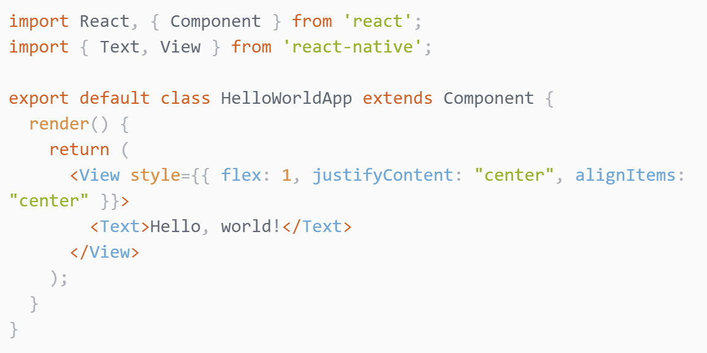
Hello World!
Notes:
John

Slide 7
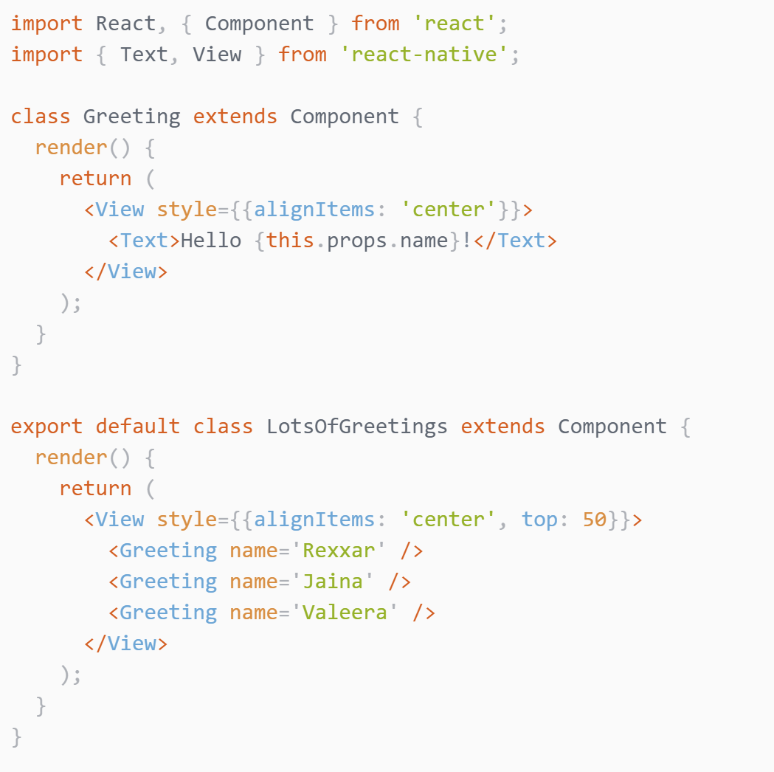
Props, Again
Notes:
John

Slide 8
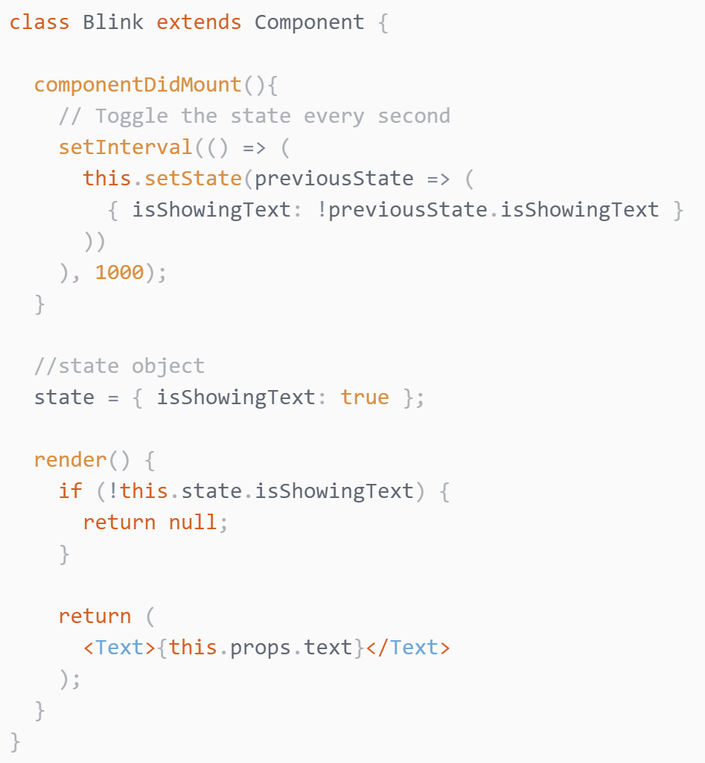
State
For things we need to store and modify
Initialize State in the constructor
Mutate State using the setState function
For passing things through the hierarchy use props, not state
Notes:
John

Slide 9
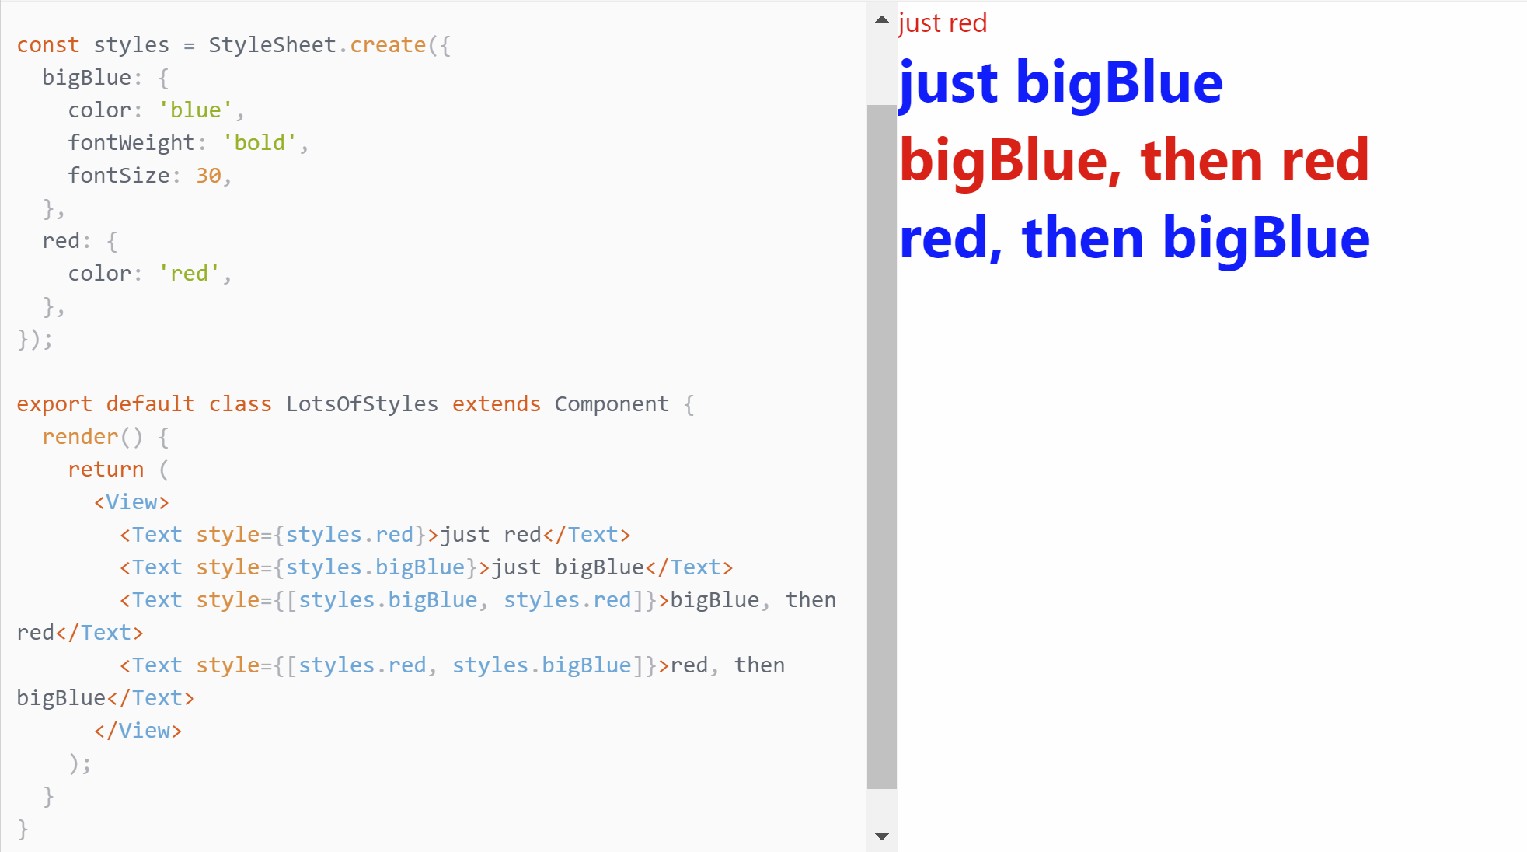
Style
Notes:
John

Slide 10
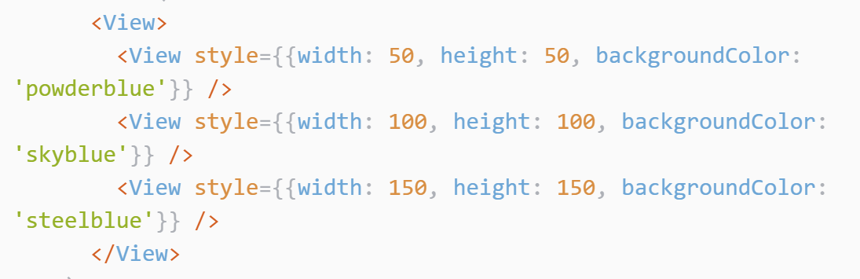
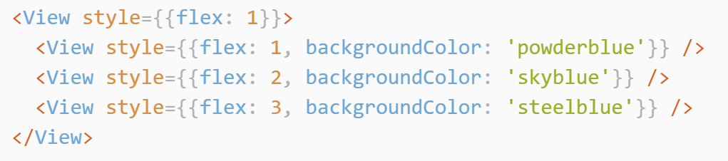
Height and Width
Fixed Dimensions
For components that should always be the same size regardless of screen size
All dimensions in React Native are unitless, and represent density-independent pixels
Flex Dimensions
Expand and shrink dynamically based on available space
Need flex or fixed width or height in parent otherwise invisible
Notes:
John
A component can only expand to fill available space if its parent has dimensions greater than 0. If a parent does not have either a fixed width and height or flex, the parent will have dimensions of 0 and the flex children will not be visible.

Slide 11
Layout with Flexbox
flexDirection: controls the direction in which the children of a node are laid out. This is also referred to as the main axis. The cross axis is the axis perpendicular to the main axis.
Options: row, column, row-reverse, column-reverse
justifyContent: how to align children within the main axis of their container.
Options: flex-start, flex-end, center, space-between, space-around, space-evenly
alignItems: how to align children along the cross axis of their container. Very similar to justifyContent but instead of applying to the main axis, alignItems applies to the cross axis.
Options: stretch, flex-start, flex-end, center. AlignSelf.
FlexWrap: wrap & nowrap
Position: Absolute & relative
Notes:
Flexbox works the same way in React Native as it does in CSS on the web, with a few exceptions. The defaults are different, with flexDirection defaulting to column instead of row, and the flex parameter only supporting a single number.
John

Slide 12
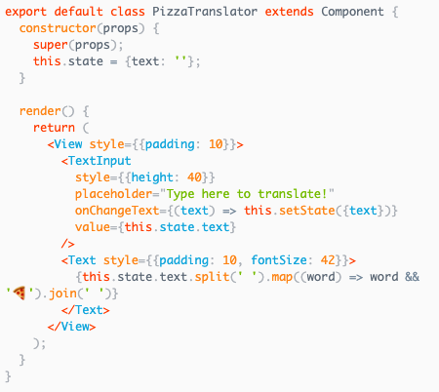
Handling TextInput
-component that allows user to enter text
-props: onChangeText & onSubmitEditing
Notes:
Shelby
onChangeText: takes a function that’s called every time the text changes
onSubmitEditing: takes a function that’s called when texts is submitted

Slide 13





Handling Touches
Button Components
Touchable Components
-
Notes:
Shelby
-buttoncomponent
-touchablecomponents: like a custom button, use different touchable components for different types of feedback
-touchable highlight: view’s background darkens when you press on component

Slide 14
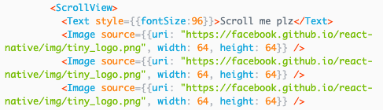
Using a ScrollView
-scrolling containers that can contain multiple components and views
-props: pagingEnabled, maximumZoomScale, minimumZoomScale
-all elements and views rendered even if not shown on screen
Notes:
Shelby
-can scroll vertically and horizontally by setting horizontal property
-pagingEnabled - swipe through views
-maximumZoom and minimumZoom - allow user to zoom in and zoom out
-all elements and views rendered even if they’re not shown on screen

Slide 15
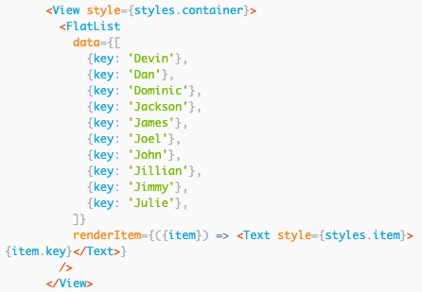
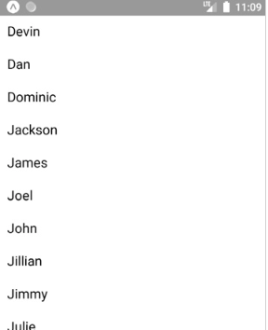
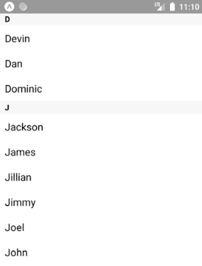
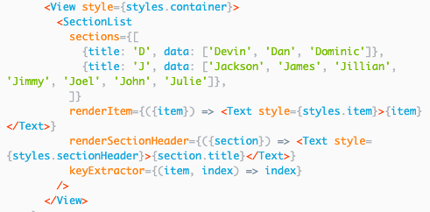
Using List Views
-component for presenting lists of data
FlatList SectionList
Notes:
Shelby
only renders elements & views that are currently showing on screen (not all elements), good for longs lists of data
- data prop is source of info for list & renderItem returns a component to render from data
-SectionList: set of data broken into sections
-common use is to display data you fetch from server

Slide 16
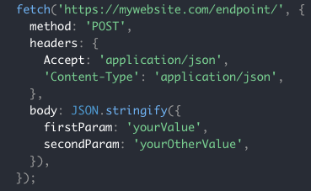
Networking
-provides fetch API
-can use async / await syntax
-supports WebSockets
Notes:
Shelby
-most mobile apps need to load resources from a remote URL

Slide 17
Demo!
snack.expo.io/@johnvalin/todo-template
Notes:
Both
https://medium.com/swlh/writing-your-really-first-mobile-app-in-react-native-simple-to-do-app-e67f875f0721

Slide 18
Completed Example
snack.expo.io/@johnvalin/full-todo-app
Notes:
Both
https://medium.com/swlh/writing-your-really-first-mobile-app-in-react-native-simple-to-do-app-e67f875f0721

Slide 19
Additional Resources
https://facebook.github.io/react-native/
https://github.com/ReactNativeNews/React-Native-Apps
Notes:
Shelby

Slide 20
Questions?
Notes:
Both
https://medium.com/swlh/writing-your-really-first-mobile-app-in-react-native-simple-to-do-app-e67f875f0721

